Slide 1

JAWAHARLAL NEHRU TECHNOLOGICAL UNIVERSITY KAKINADA UNIVERSITY COLLEGE OF ENGINEERING VIZIANAGARAM DEPARTMENT OF ELECTRONICS AND COMMUNICATION ENGINEERING(E.C.E)
IMPLEMENTATION OF VISION FOR ROBOTS
PROJECT MEMBERS:
B. Gururaja : 17VV1A0407
G. Krishna Rao : 18VV5A0465
K. Eshwar Ajay : 17VV1A0423
K. Saicharan : 17VV1A0426
Md. Shoaib Shariff : 17VV1A0433
PROJECT GUIDE
Prof.CH.Srinivasa Rao
Department of ECE.

Slide 2
Insight:
Motivation
Introduction to computer vision.
Keypoints and its Significance.
Steps in SIFT algorithm
Scale-space extrema detection
Keypoint Localization
Orientation Assignment
Keypoint descriptor
SIFT implementation using Matlab.
SIFT implementation using Python.
SIFT implementation using Xilinx System Generator
Conclusion and Future Scope
References

Slide 3
Motivation
Object recognition is one of the main problems that Computer Vision tries to solve.
Object recognition techniques try to identify an object in an image or a stream of images. The main purpose of these techniques is to find a way of describing the desired object, and use this description to identify the same object in another image with reliable accuracy and satisfactory performance.
This represents a huge challenge, because the accuracy depends generally on the number of keypoints used to describe an object. And this will result in decreasing the performance due to the need of more computations.
In this we will implement SIFT algorithm for Image Processing.

Slide 4
Computer Vision
Computer Vision is an important feature for Robots in many real time applications.
Object detection, recognition and tracking can be done using this vision.
Object recognition is used in many applications such as: Manufacturing Industry, face recognition for security purposes, vehicle tracking or any real time embedded system that requires object identification from an image or a stream of images.
The field of computer vision provides number of algorithms for object detection and recognition. Scale Invariant Feature Transform (SIFT) is an efficient feature detection algorithm.

Slide 5
Keypoints and its Significance:
Keypoints are the same thing as interest points.
They are spatial locations, or points in the image that define what is interesting or what stand out in the image.
Interest point detection is actually a subset of blob detection (detecting regions in a digital image that differ in properties, such as brightness or color, compared to surrounding regions), which aims to find interesting regions or spatial areas in an image.
The reason why keypoints are special is because no matter how the image changes whether the image rotates, shrinks/expands or is subject to distortion, you should be able to find the same keypoints in this modified image when comparing with the original image.

Slide 6
SIFT
Scale Invariant Features Transform (SIFT) is an algorithm used to locate the keypoints features of an image and create a descriptor for each keypoint. These descriptors can be used to detect an object or a pattern in an image.
Scale-space extrema detection
Key point Localization
Orientation Assignment
Key point descriptor

Slide 7
SIFT FLOWCHART

Slide 8
Scale-space extrema detection :
SIFT uses DoG as an approximation to Laplacian of Gaussian, because the Laplacian of Gaussian is computationally expensive compared to DoG.
This step is used to make it possible to detect the scaled keypoint using the same window.
Then the extrema is obtained from the resulting image.
Each pixel is compared to its 8 direct neighbouring pixels (in the same scale) and with the 18 pixels of the previous and the next scales.
Thus, in total each pixel is compared with its 26 neighbouring pixels

Slide 9
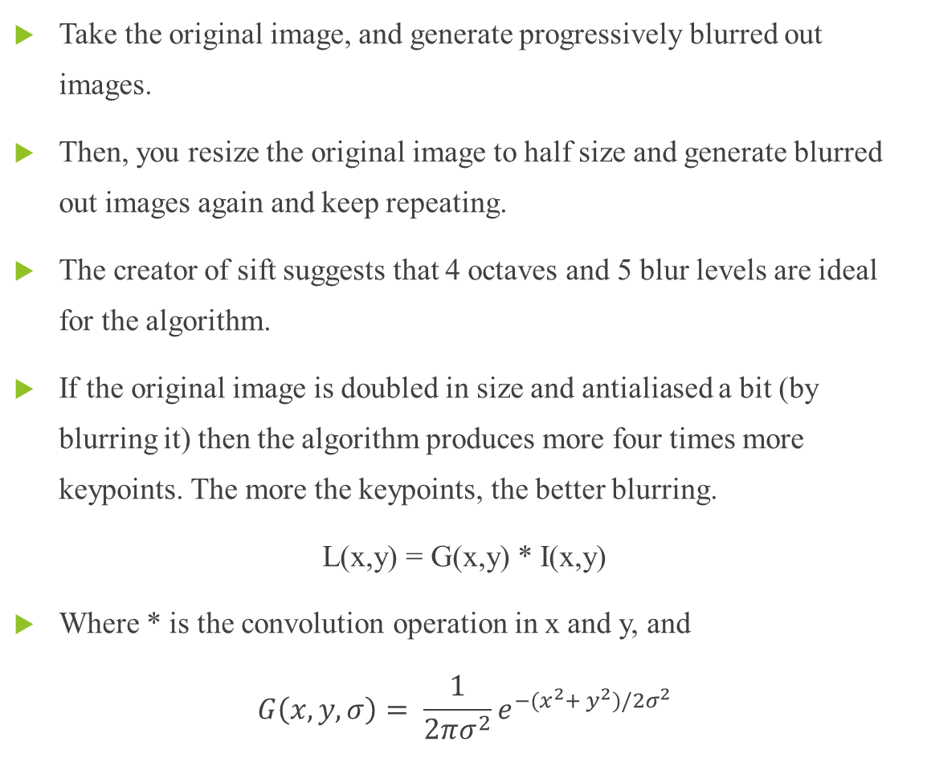
Constructing a Scale Space:
Take the original image, and generate progressively blurred out images.
Then, you resize the original image to half size and generate blurred out images again and keep repeating.
The creator of sift suggests that 4 octaves and 5 blur levels are ideal for the algorithm.
If the original image is doubled in size and antialiased a bit (by blurring it) then the algorithm produces more four times more keypoints. The more the keypoints, the better blurring.
L(x,y) = G(x,y) * I(x,y)
Where * is the convolution operation in x and y, and
$$G\left(x,y,σ\right)= \frac{1}{2πσ^{2}}e^{−(x^{2}+ y^{2})/2σ^{2}}$$

Slide 10
Constructing a Scale Space:
(A) Octave 1
(B) Octave 2
(C) Octave 3
(D) Octave 4

Slide 11
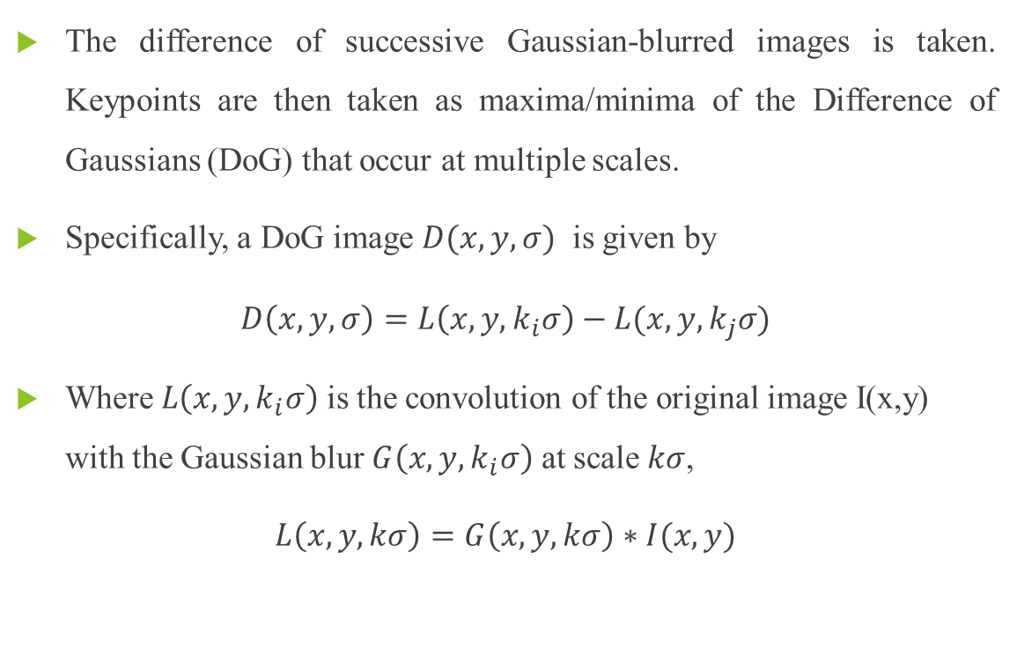
DoG Approximation:
The difference of successive Gaussian-blurred images is taken. Keypoints are then taken as maxima/minima of the Difference of Gaussians (DoG) that occur at multiple scales.
Specifically, a DoG image $D(x,y,σ)$ is given by
$D\left(x,y,σ\right)=L\left(x,y,k_{i}σ\right)−L(x,y,k_{j}σ)$
Where $L\left(x,y,k_{i}σ\right)$ is the convolution of the original image I(x,y) with the Gaussian blur $G\left(x,y,k_{i}σ\right)$ at scale$kσ$,
$L\left(x,y,kσ\right)=G\left(x,y,kσ\right)∗I(x,y)$

Slide 12
DoG Approximation:

Slide 13
Why DoG is used?
DoG is a feature enhancement algorithm that involves the subtraction of one Gaussian blurred version of an original image from another, less blurred version of the original.
The blurred images are obtained by convolving the original grayscale images with Gaussian kernels having differing width.
Blurring an image using a Gaussian kernel suppresses only high-frequency spatial information.
Subtracting one image from the other preserves spatial information that lies between the range of frequencies that are preserved in the two blurred images.
The difference of gaussians (DoG) algorithm is useful for enhancing edges in noisy digital images.

Slide 14
Finding Keypoints:
Once DoG images have been obtained, keypoints are identified as local minima/maxima of the DoG images across scales.
This is done by comparing each pixel in the DoG images to its eight neighbours at the same scale and nine corresponding neighbouring pixels in each of the neighbouring scales.
If the pixel value is the maximum or minimum among all compared pixels, it is selected as a candidate keypoint.

Slide 15
Finding Keypoints:
(A) Comparing pixel with 26 other pixels

Slide 16
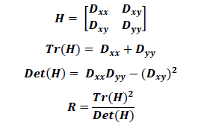
Keypoint Localization :
DoG has high response for edges, so edges should be removed.
For this, SIFT used Hessian matrix to compute the principal curvature and if the ratio is greater than a threshold the edge is removed.
Where H is the Hessian matrix of the image, Tr(H) is the trace of the matrix H, DET(H) is the determinant of H, R is the ratio.

Slide 17
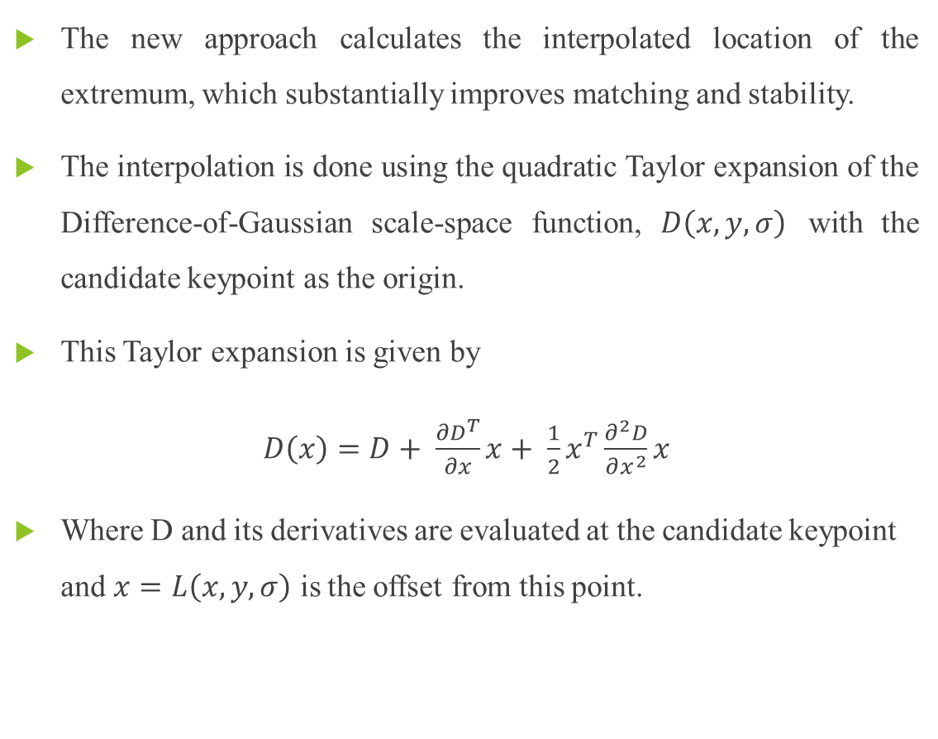
Locate Keypoints:
The new approach calculates the interpolated location of the extremum, which substantially improves matching and stability.
The interpolation is done using the quadratic Taylor expansion of the Difference-of-Gaussian scale-space function, $D\left(x,y,σ\right)$ with the candidate keypoint as the origin.
This Taylor expansion is given by
$D\left(x\right)=D+ \frac{∂D^{T}}{∂x}x+ \frac{1}{2}x^{T}\frac{∂^{2}D}{∂x^{2}}x$
Where D and its derivatives are evaluated at the candidate keypoint and $x=L\left(x,y,σ\right)$ is the offset from this point.

Slide 18
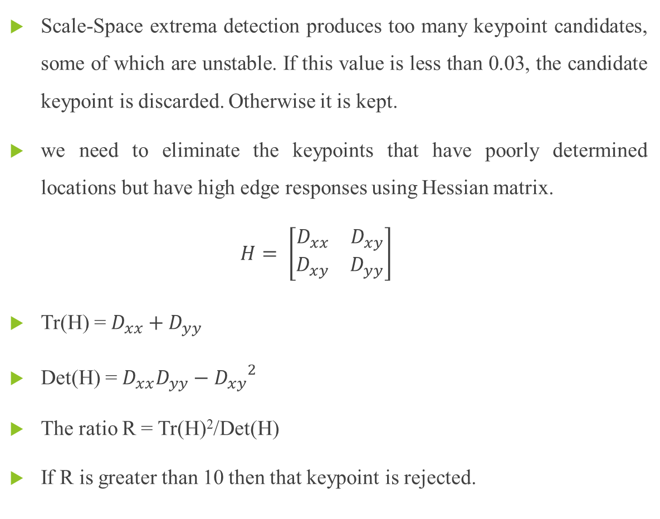
Get Rid of Bad Keypoints:
Scale-Space extrema detection produces too many keypoint candidates, some of which are unstable. If this value is less than 0.03, the candidate keypoint is discarded. Otherwise it is kept.
we need to eliminate the keypoints that have poorly determined locations but have high edge responses using Hessian matrix.
$$H= \left[\begin{matrix}D_{xx} & D_{xy} \\ D_{xy} & D_{yy}\end{matrix}\right]$$
Tr(H) = $D_{xx}+D_{yy}$
Det(H) = $D_{xx}D_{yy}−{D_{xy}}^{2}$
The ratio R = Tr(H)²/Det(H)
If R is greater than 10 then that keypoint is rejected.

Slide 19
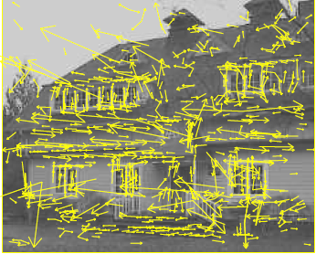
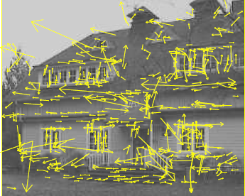
Get Rid of Bad Keypoints:
(A) The initial 832 keypoints locations at maxima and minima of the DoG
(B) The final 536 keypoints that remain
following an additional threshold on ratio of principal curvatures.

Slide 20
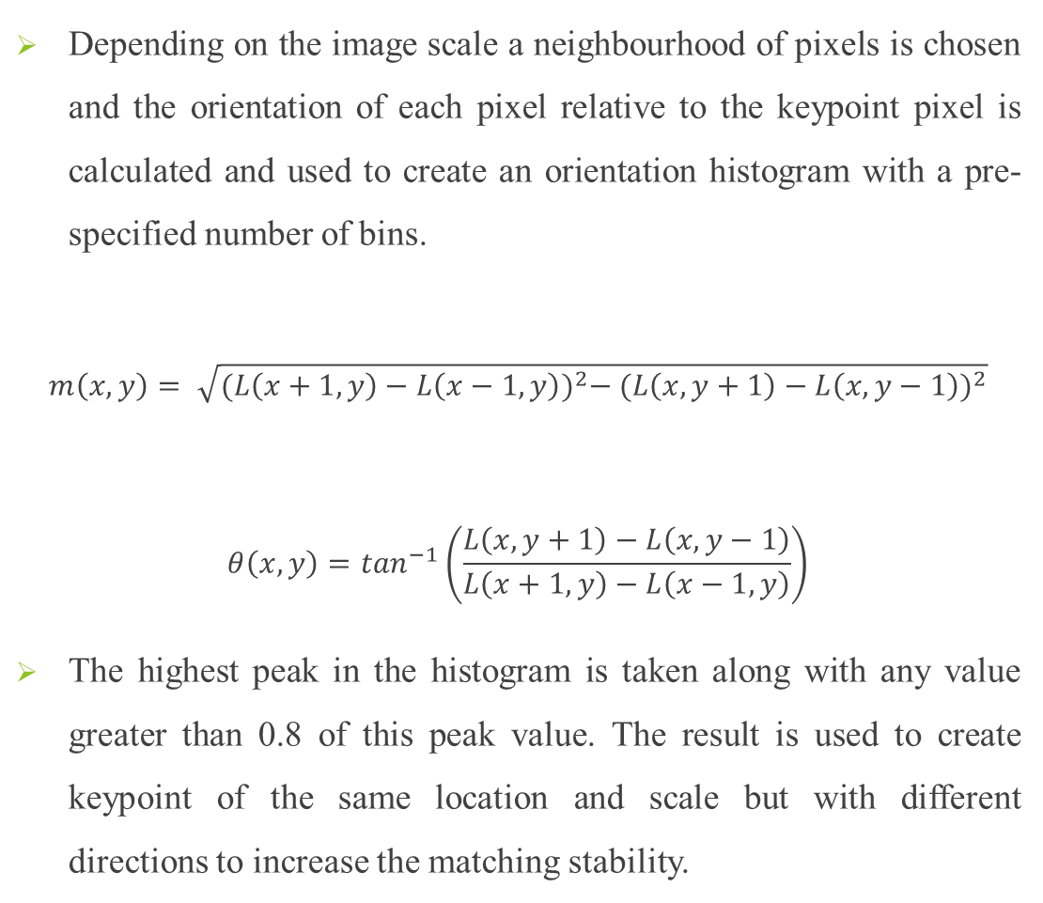
Orientation Assignment :
Depending on the image scale a neighbourhood of pixels is chosen and the orientation of each pixel relative to the keypoint pixel is calculated and used to create an orientation histogram with a pre-specified number of bins.
$$m\left(x,y\right)= \sqrt{{(L\left(x+1,y\right)−L\left(x−1,y\right))}^{2}− {(L\left(x,y+1\right)−L\left(x,y−1\right))}^{2}}$$
$$θ\left(x,y\right)=\tan^{−1}\left(\frac{L\left(x,y+1\right)−L\left(x,y−1\right)}{L\left(x+1,y\right)−L\left(x−1,y\right)}\right)$$
The highest peak in the histogram is taken along with any value greater than 0.8 of this peak value. The result is used to create keypoint of the same location and scale but with different directions to increase the matching stability.

Slide 21
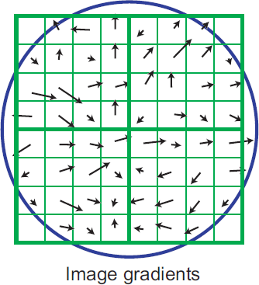
Assigning Orientation to Keypoints :
Gradient Magnitude
Orientation
Assign the dominant orientation as the orientation of the keypoint.

Slide 22
Keypoint descriptor :
A descriptor is created using the orientation bin histogram represented as a vector, forming keypoint descriptor along with some measurements to achieve robustness.
Once the descriptor is created it can be used to identify an object in another image by comparing this descriptor with target image’s descriptor.
Usually the matching process take into account the nearest neighbour, but sometimes the second-closest match is closer than the nearest match due to noise.
Hence, a ratio between the closest and the second-closest distance is taken and if it’s greater than 0.8 they are rejected.

Slide 23
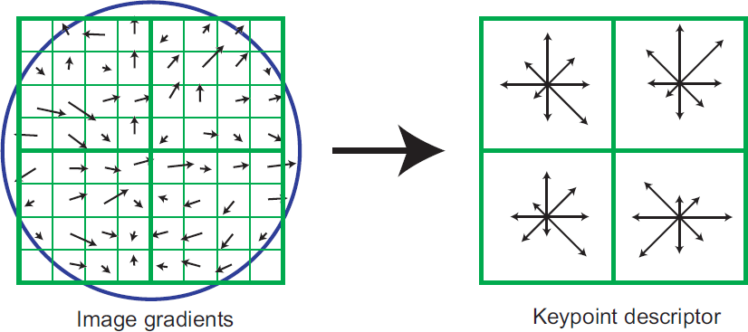
Keypoint descriptor :
length of each descriptor is 128 which is invariant to rotations due to the sorting.

Slide 24
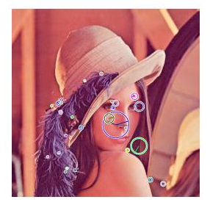
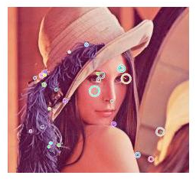

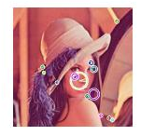
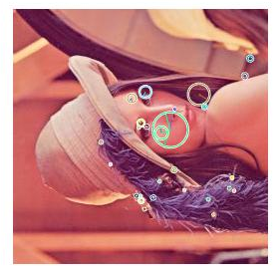
RESULTS OF KEYPOINT DETECTION OBTAINED BY USING MATLAB:
(A) Original Image
(B) Cropped Image
(C) Image with Gaussian Noise
(D) Rotated Image
(E) Scaled Image

Slide 25
PSNR and SSIM Values of Different Images with Reference to Original Image in Matlab:
S.NO | Different Images (Lena) | PSNR | SSIM
1 | Cropped Image | 15.1963 | 0.7925
2 | Image with Gaussian Noise | 27.6841 | 0.9702
3 | Rotated Image | 15.5792 | 0.8288
4 | Scaled Image | 11.9194 | 0.7002

Slide 26
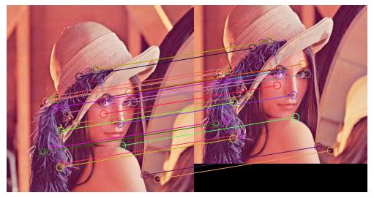
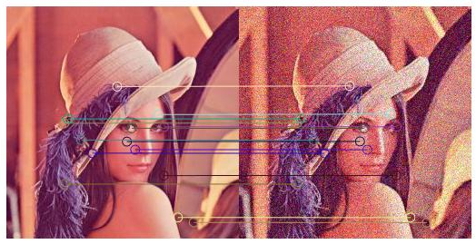
RESULTS OF FEATURE MATCHING OBTAINED BY USING MATLAB:
a)Cropped Image
(A)
(B)
b) Noise Image

Slide 27
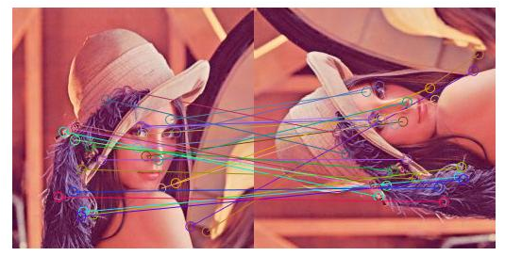
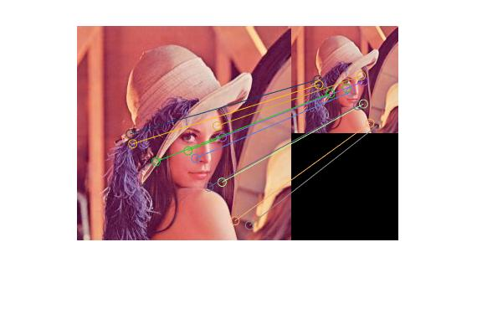
RESULTS O FEATURE MATCHING OBTAINED BY USING MATLAB:
c)Rotated Image
d) Scaled Image

Slide 28
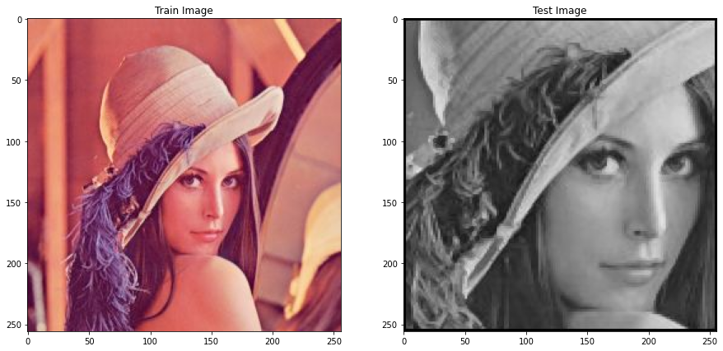
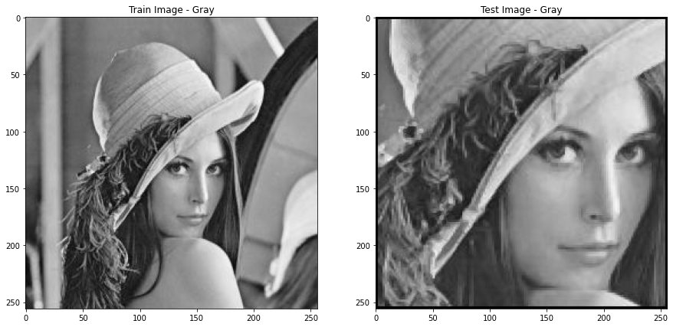
RESULTS OBTAINED BY USING PYTHON:
(a) Original image
(b) Cropped Image
PSNR: 6.1369
SSIM : 0.2904
(a) GrayScale Image
(b) GrayScale Cropped Image

Slide 29
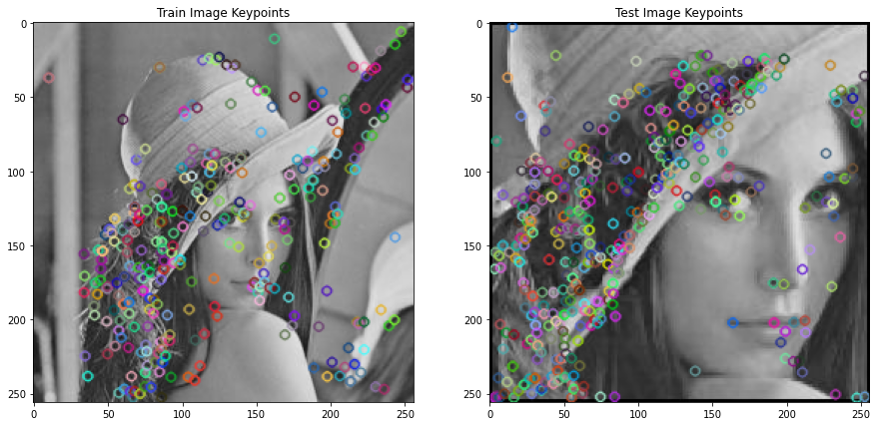
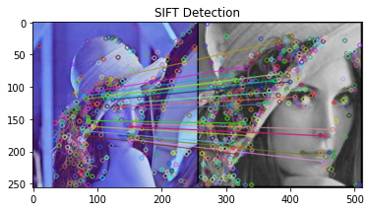
RESULTS OBTAINED BY USING PYTHON:
PSNR: 11.8850
SSIM : 0.2506
Keypoints on Original image
(b) Keypoints on Cropped image
Matched Keypoints

Slide 30
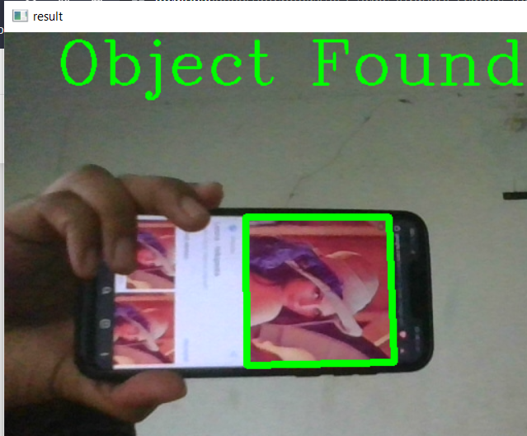
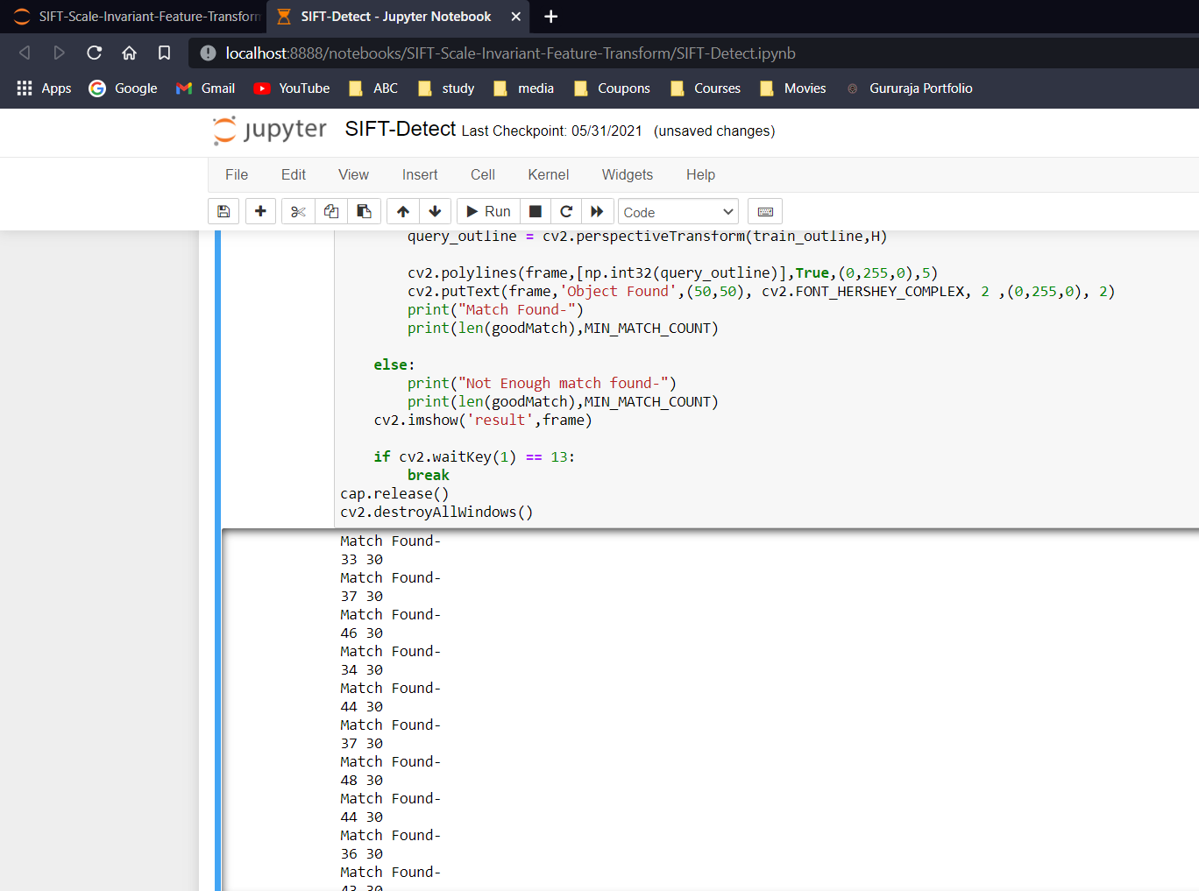
RESULTS OBTAINED BY USING PYTHON:
(a) Result of Object Detection
(b) No. of keypoints matched and minimum no. of keypoints

Slide 31
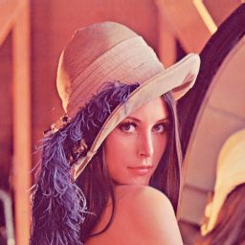
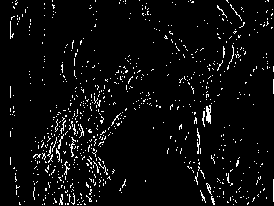
RESULTS OBTAINED BY USING XILINX-SYSTEM-GENERATOR:
(a) Original Image
(b) Keypoints identified on Image
Results of Image Keypoint Detection

Slide 32
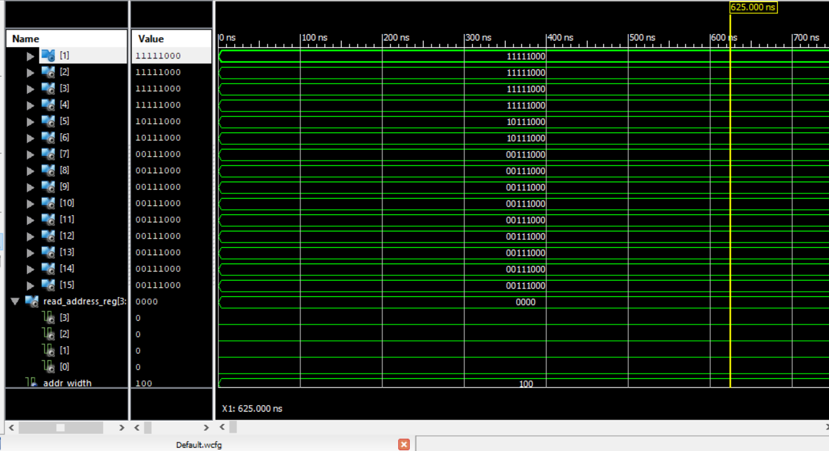
RESULTS OBTAINED BY USING XILINX
ISE 14.7 Isim:
Results of Xilinx Simulation

Slide 33
Device Utilization Summary:
Device Utilization Summary
Slice Logic Utilization | Used | Available | Utilization
Number of Slice Registers | 2,419 | 32,640 | 7%
Number used as Flip Flops | 2,419
Number of Slice LUTs | 4,119 | 32,640 | 12%
Number of occupied Slices | 1,381 | 8,160 | 16%
Number of LUT Flip Flop pairs used | 4,419
Number of fully used LUT-FF pairs | 2,119 | 4,419 | 47%
Number of bonded IOBs | 17 | 480 | 3%
Number of BlockRAM/FIFO | 88 | 132 | 66%
Number using BlockRAM only | 88
Number of 18k BlockRAM used | 154
Total Memory used (KB) | 2,772 | 4,752 | 58%

Slide 34
Conclusion And Future Scope
CONCLUSION:
Feature extraction (FE) techniques have become an apparent need in many processes which have much to do with computer vision, object detection and location, image processing, image retrieval.
In this we discussed about the SIFT algorithm, it’s implementation. We examined steps to be carried in SIFT algorithm for feature extraction on different software’s such as MATLAB, XILINX-SYSTEM-GENERATOR and PYTHON. Feature extraction is used in object recognition.

Slide 35
Conclusion And Future Scope :
FUTURE SCOPE :
The proposed techniques for feature extraction has been done i.e, implementing SIFT for images. Depending on the interval length in the scale space keypoints are preferred in SIFT algorithm.
In future a complete framework can be developed which can check the image and automatically matches the keypoints with the large database of images with less computational complexity.
The same can be further implemented also for video processing.

Slide 36
REFERENCES
[1]. Lifan Yao, Hao Feng, Yiqun Zhu, Zhiguo Jiang, Danpei Zhao, and Wenquan Feng - “An architecture of optimised SIFT Feature Detection for an FPGA Implementation of an Image Matcher”, IEEE FPT, pp. 30-37, 2009.
[2]. Vanderlei Bonato, Eduardo Marques and Gearge A. Constantinides “A Parallel Hardware Architecture for Scale and Rotation Invariant Feature Detection”, IEEE Transactions on Circuits and Systems for Video Technology. (Vol.1 8-No12), pp.1-11,2008.
[3]. Ana Brandusa Pavel and Catalin Buiu - “Development of an embedded Artificial Vision System for an Autonomous robot”-International Journal of Innovative Computing Information and Control, Volume-7 Number-2 Issue-11 February 2011 pp.745-762, 2011.
[4]. David G. Lowe - “Distinctive Image Features from Scale-Invariant Keypoints”-International Journal of Computer Vision,2004.

Slide 37
REFERENCES
[5]. Sudipta N, Sinha, Jan-Michael Frahm, Mare Pollefeys and Yakup Genc - “Feature tracking and matching in Video using programmable graphics hardware”- Springer Veralag London Limited, Machine Vision and Apllications,2007.
[6]. Kosuke Mizuno, Hiroki Noguchi, Guangji He, Yosuke Terachi, Tetsuya Kamino, Hiroshi Kawaguchi and Masahiko Yoshimoto - “Fast and Low memory bandwidth architecture of SIFT descriptor generation with scalability on speed and accuracy for VGA video”, IEEE International Conference on Field Programmable Logic and applications, pp.608-611, 2010.
[7]. Lakshmana Kumar.A, Dr.R.Ganeshan “Improved navigation for visually challenged with high authentication using a modified algorithm”, International Journal of Advanced Research in Computer Science and Technology Vol.2 Issue Special 1, pp. 434-438, 2014.
[8]. Valeriu Codreanu, Feng Dong, Baoquan Liu, Jos B.T.M.Roerdink, David Williams, Po Yang and Burhan Yasar - “GPU-ASIFT: A Fast Fully Affine- Invariant Feature Extraction Algorithm”, IEEE-2013.

Slide 38
THANK YOU

